Slide 1

Banqi | GLAAD
GLAAD Lucas Aaron Alex Alex Devin

Slide 2
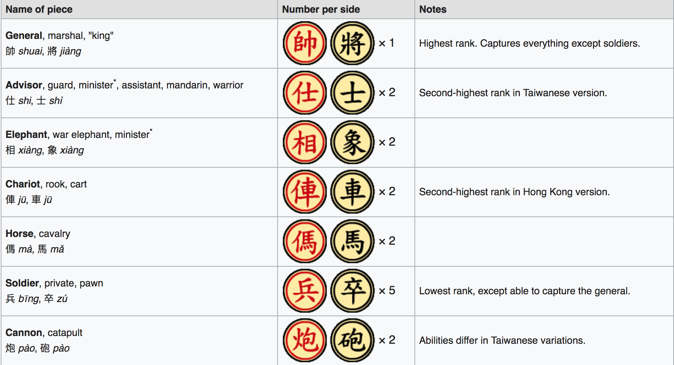
BANQI
Setup:
2 players (preferably in good health)
16 Xiangqi chess pieces (Chinese Chess Pieces)
Pieces are placed faced down in the squares of a four by eight grid.
Alternate names:
Dark Chess
Blind Chess

Slide 3
Game Play
Pieces start upside down and randomized
Players take turns
flipping a piece
moving their piece
capturing an opponent's piece
There are different variations from Taiwan and Hong Kong

Slide 4
Moving

Slide 5
Captures
Notes:
worth mentioning:
Only pieces of equal or lower rank may be captured, with one exception.
a chariot may capture a horse, and the general may capture either, but a horse cannot capture a chariot, and neither can capture the general.
The one exception concerns generals and soldiers: the general cannot capture soldiers, and soldiers can capture the general.

Slide 6
Use Case 1
Use case id: | EU-3
Use case name: | Inviting players
Overview: | Allows User to invite one or more additional players to their game
Type: | Primary
Actors: | User {Initiator} {Primary} Invited Players {primary}
Secondary actors: | N/A
Properties: | Performance:N/A Security:N/A Other:N/A
Pre-conditions: | User has created a game instance
Main Flow: | 1) User provides a list of players to invite 2) Invited Players are notified they’ve been invited 3) An Invited Player joins the game 4) All outstanding invitations are revoked
Subflows: | N/A
Alternative flows: | Instead of step 3, the user who creates the invite chooses to cancel it.
Post-conditions: | An Invited Player is still in the game
Cross references: | EU-4

Slide 7
Use Case 2
Use case id: | EU-4
Use case name: | Joining a game
Overview: | The first player to accept an invite joins the game
Type: | primary
Actors: | Invited Player {Initiator} {Primary}
Secondary actors: | User
Properties: | Performance: N/A Security: N/A Other:N/A
Pre-conditions: | A game instance has been created by User and invitations have been sent out
Main Flow: | 1) Invited Player receives the invitation to User’s game 2) Invited Player accepts invitation 3) Invited Player joins User’s game.
Subflows: | N/A
Alternative flows: | 1) The invitation has already been accepted by someone else. Post-condition: Invited Player is notified that the game is full
Post-conditions: | Invited Player joins User’s game
Cross references: | N/A

Slide 8
Use Case 3
Use case id: | EU-5
Use case name: | Invitation Rejection
Overview: | Invited Players should be able to reject an invitation.
Type: | primary
Actors: | Invited Player {Initiator} {Primary} User {Primary}
Secondary actors: | N/A
Properties: | Performance:N/A Security:N/A Other:N/A
Pre-conditions: | A game has been initiated by User and User has sent Invited Player an invitation.
Main Flow: | 1) Invited Player receives invitation from User. 2) Invited Player rejects invitation. 3) User is notified of Invited Player’s rejection.
Subflows: | N/A
Alternative flows: | N/A
Post-conditions: | Invited Player does not join User’s game, User’s invitation is still active to other players. User is notified of rejection.
Cross references: | N/A

